Slide 1

EMBEDDED SYSTEM PROJECT SUPERVISED BY DR.BILAL ZAHRAN
COLLEGE OF ARTIFICAL INTELLIGENCE
AUTONOMOUS SYSTEM DEPT .
TEAM MEMBER :
Abdullah AL-kawaldeh
Mahmoud Abu Awad
Mohammed Hamdan

Slide 2
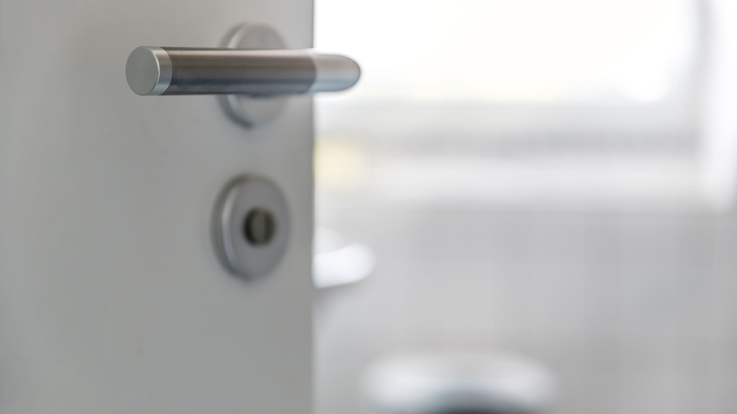
INTELLIGENCE Door Lock System

Slide 3
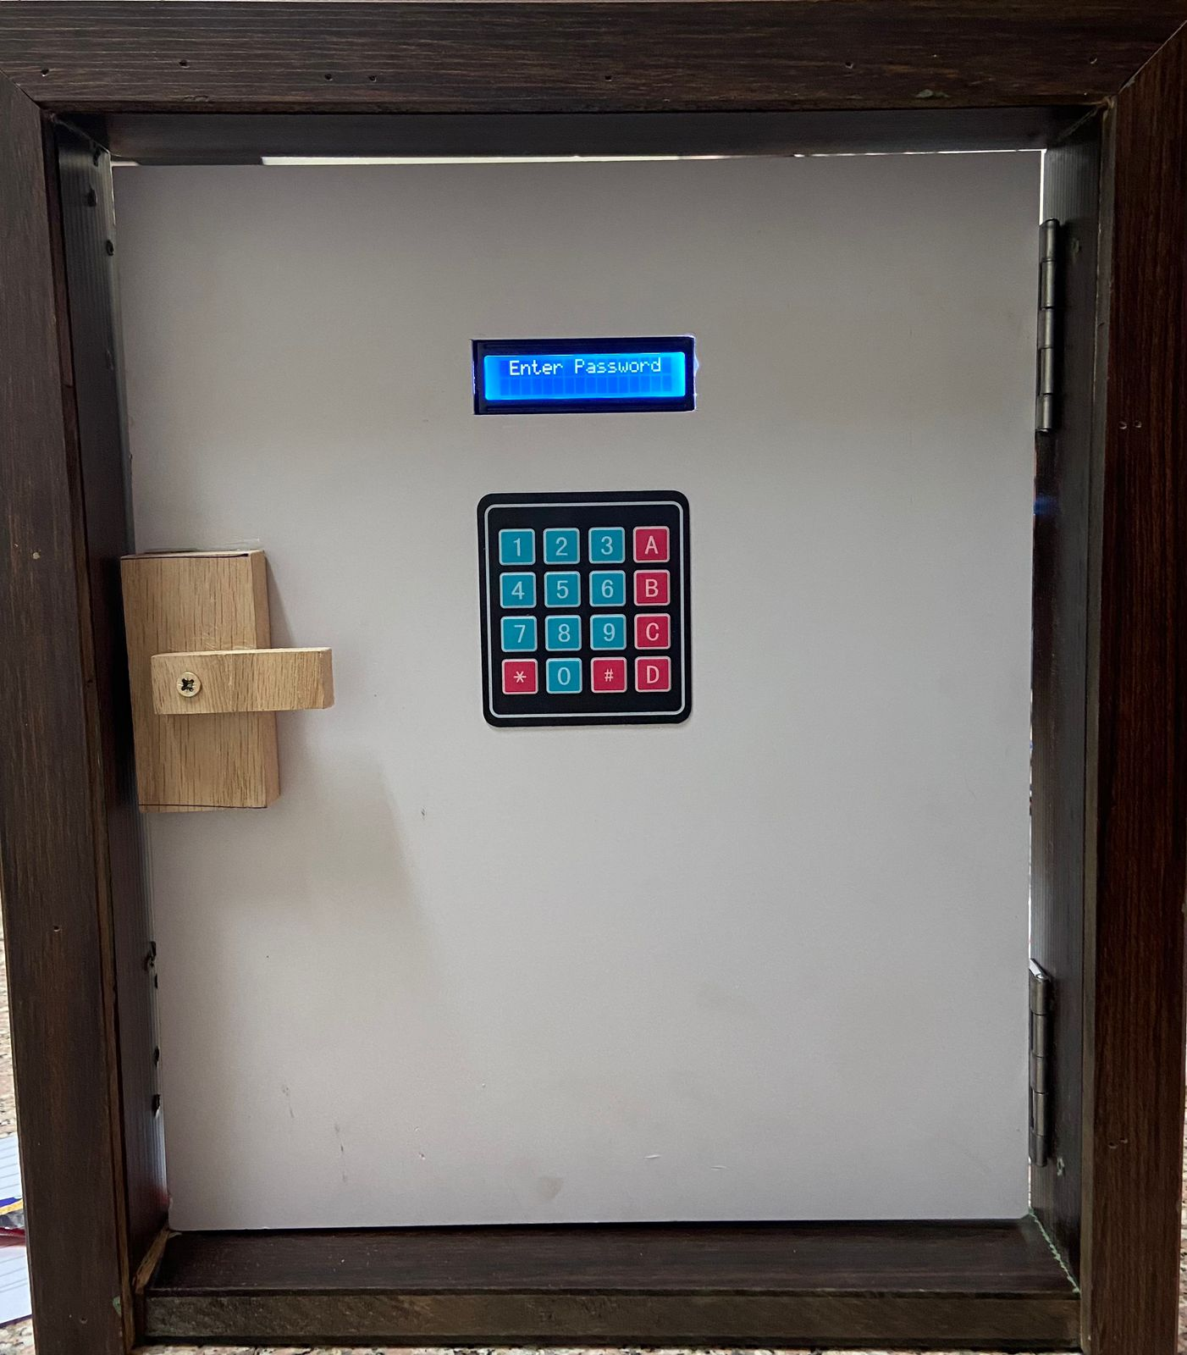
.

Slide 4
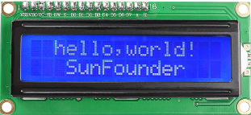
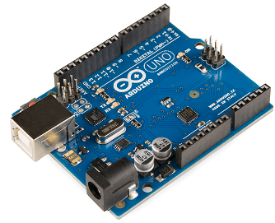

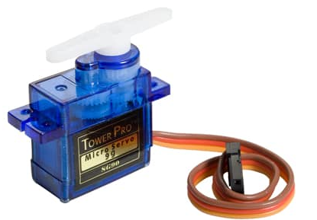
USED EQUIPMENS
L C D
Arduino uno
I 2 C
servo motor

Slide 5
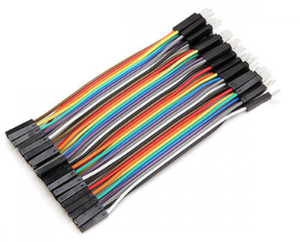
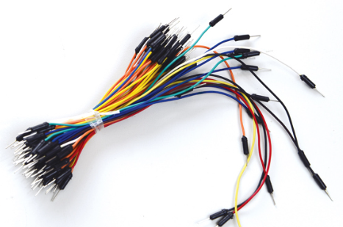
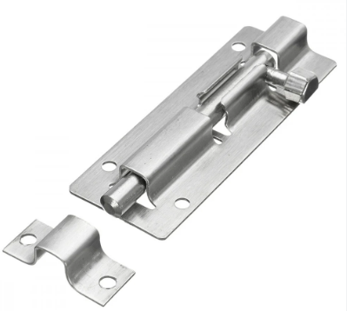
USED EQUIPMENTS
WIRES
LOCK

Slide 6
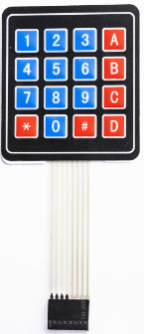
KEYBAD

Slide 7
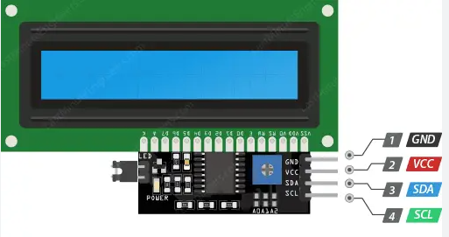
SOLDER THE LC D WITH I 2 C

Slide 8
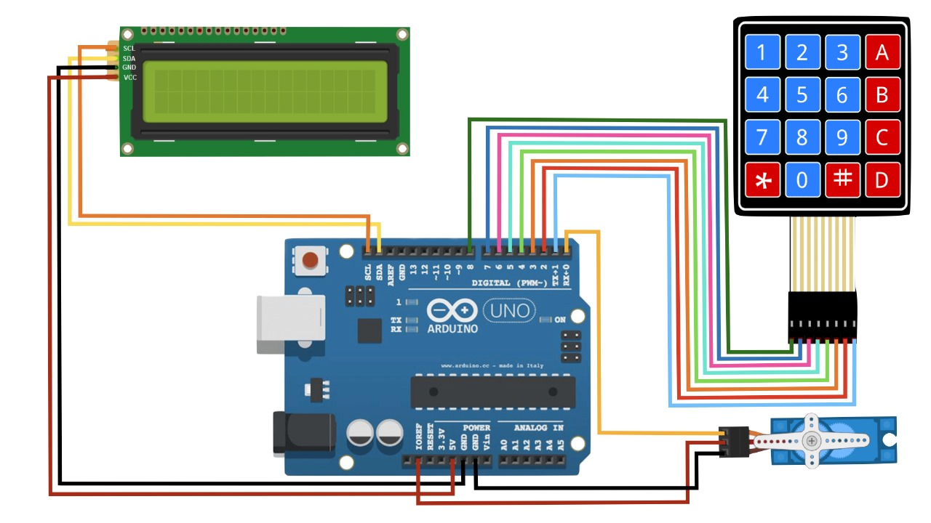
C I RC UI T
DI AGRAM

Slide 9
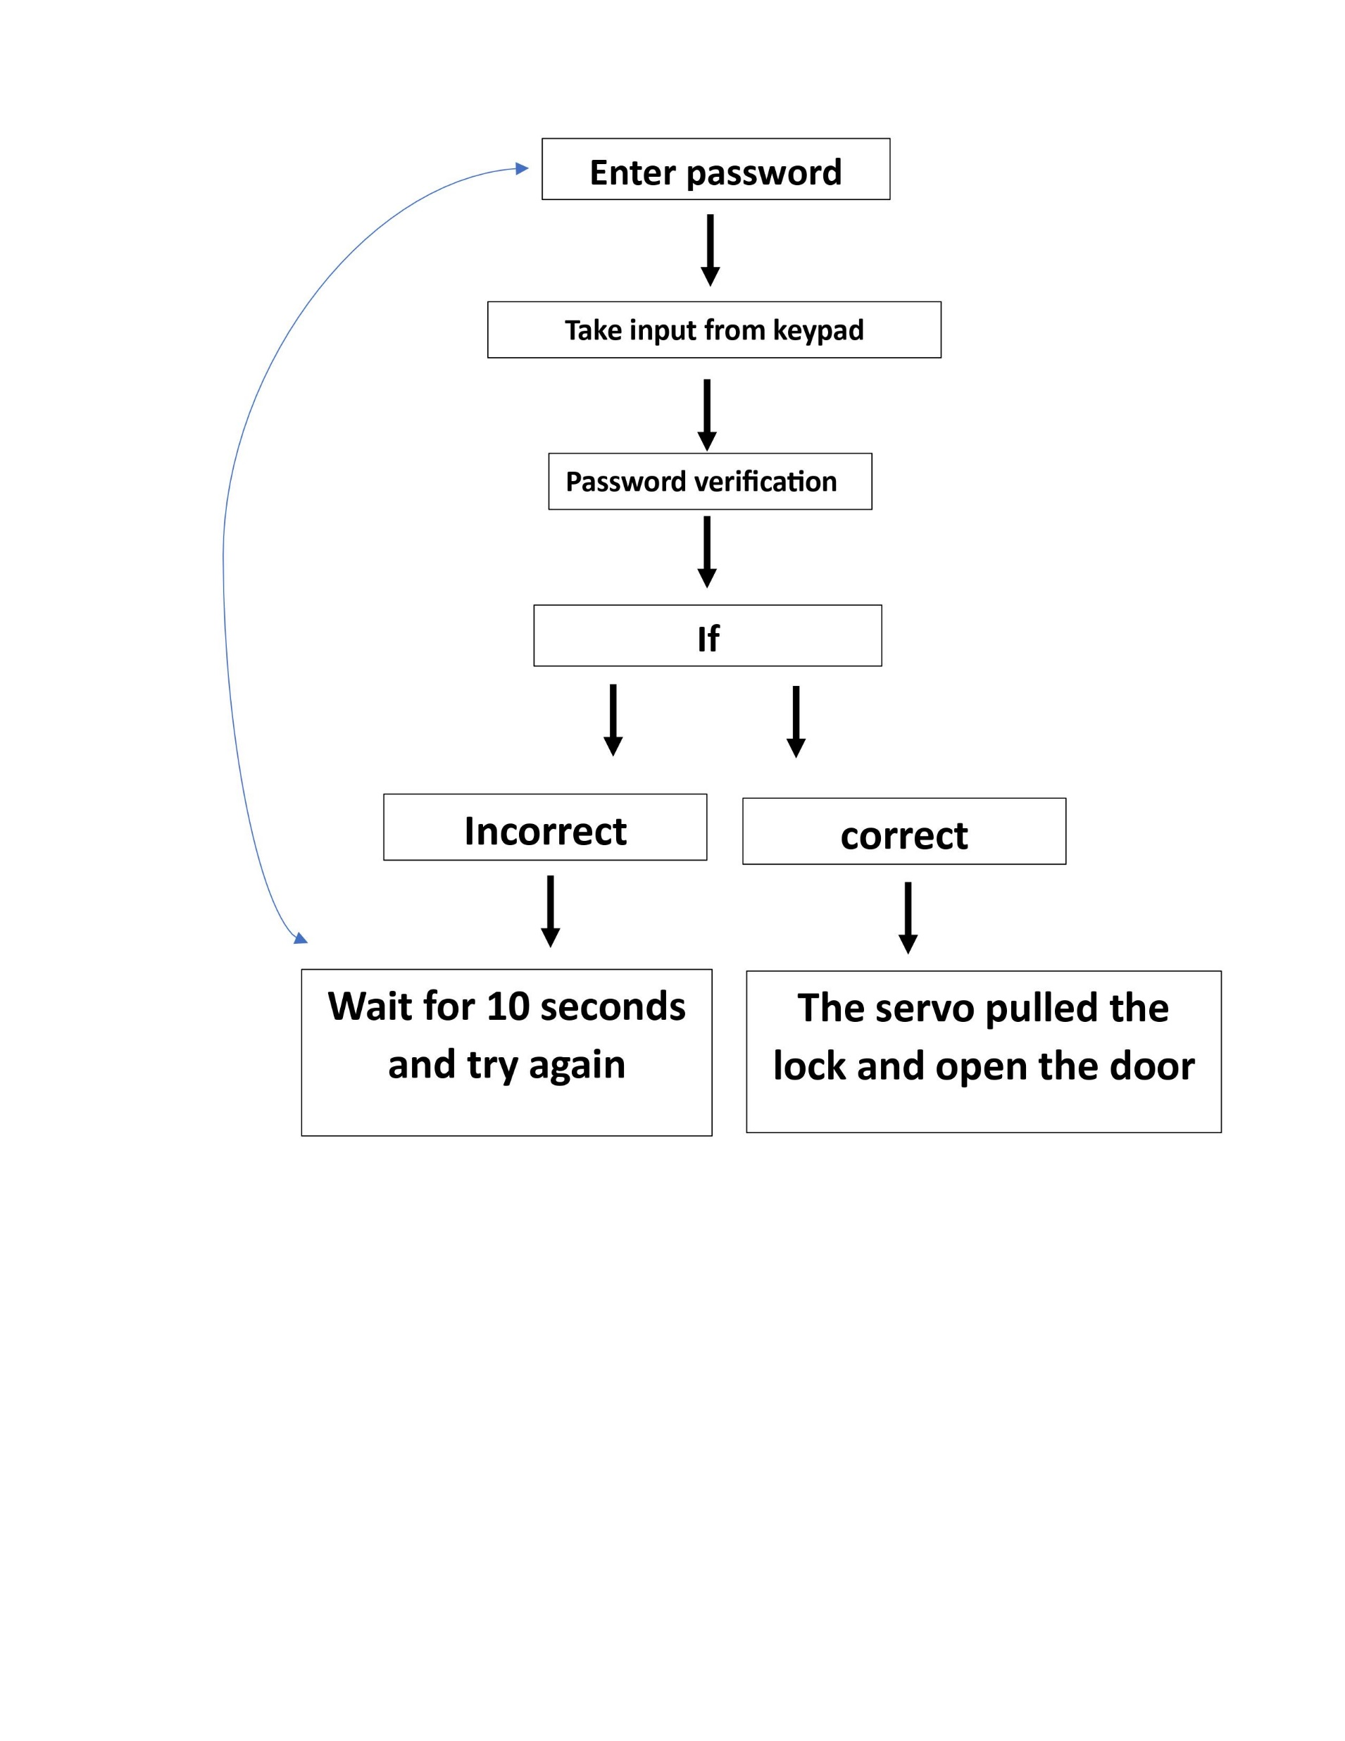

Slide 10
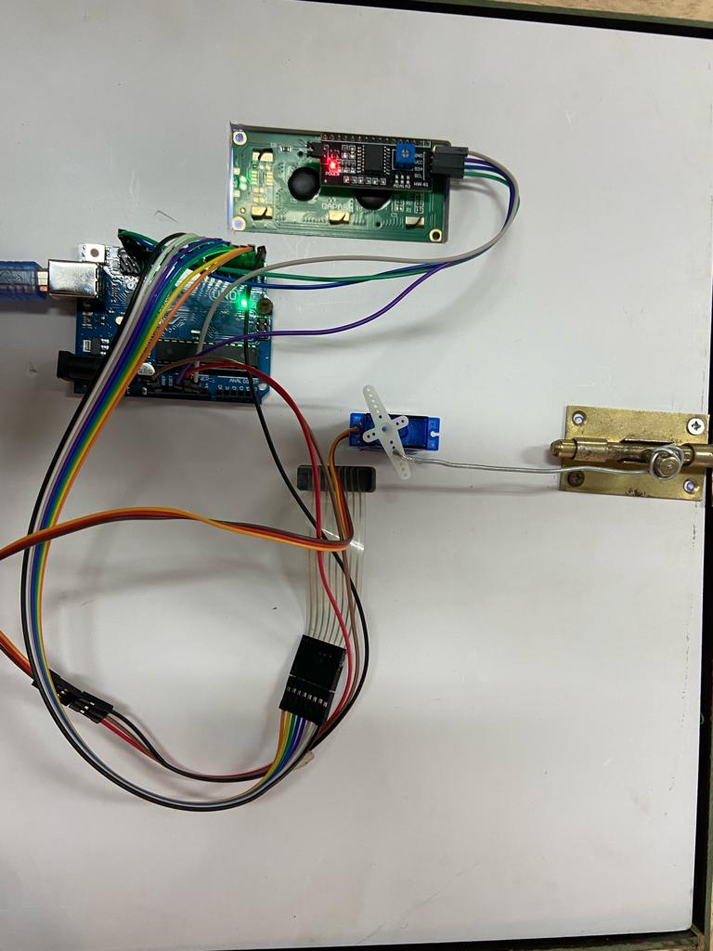

Slide 11
CODE
CLICK TO ENTER THE CODE

Slide 12



1 3 7 9 2 6 A
PASSWORD
OPEN LOC K

Slide 13
C LOSE LOC K C LI C K ON #

Slide 14
END
THANK YOU

